Slide 1
Spreading Germs
Pharmabees - Cardiff University

Slide 2
Viruses
Viruses are very small particles capable of infecting every type of living organism
They are microscopic, and you need a powerful microscope to see them
The Corona virus is 120nm in diameter
About 500 million could fit on to the head of a pin
They are parasitic and can only reproduce inside living cells
Viruses are the most successful life forms on our planet in terms of numbers
1 billion times the number of stars in the universe
They primarily infect bacteria and other life forms
Viruses can infect humans, such as the common cold or flu
Antibiotics cannot treat viral infections
Notes:
https://www.who.int/emergencies/diseases/novel-coronavirus-2019/advice-for-public
https://www.bbc.co.uk/bitesize/guides/zr46fg8/revision/7

Slide 3
Spanish FLu
The Corona Virus pandemic is not the first global pandemic
A pandemic is a disease prevalent around the world
Looking back to1918 was the Spanish flu pandemic, and is the deadliest recorded pandemic in history
It infected 500 million people, about a quarter of the world's population at the time
At the time, there were no effective drugs or vaccines to treat it
People were ordered to wear masks
Schools, theaters and businesses were closed
Notes:
https://www.history.com/topics/world-war-i/1918-flu-pandemic
https://www.historians.org/publications-and-directories/perspectives-on-history/may-2009/the-great-pandemic
https://designyoutrust.com/2020/03/historical-photos-of-the-1918-spanish-flu-that-show-what-a-global-pandemic-looked-like-in-the-1910s/

Slide 4
CoVid-19
COVID-19 is a new illness that can affect your lungs and airways
It's caused by a virus called coronavirus
The main symptoms of coronavirus (COVID-19) are a high temperature and a new, continuous cough
Everyone must stay at home to help stop coronavirus (COVID-19) spreading
Wash your hands with soap and water often to reduce the risk of infection
You should be minimising time spent outside of the home and ensuring you are 2 metres apart from anyone outside of your household
If your symptoms are severe, you may need medical care until you recover
https://www.nhs.uk/conditions/coronavirus-covid-19/#overview
Notes:
https://www.nhs.uk/conditions/coronavirus-covid-19/#overview

Slide 5
bacteria
Bacteria are microscopic living organisms
Bacteria are one of the oldest organisms, we come from bacteria!
The majority of bacteria are harmless / beneficial
Good bacteria are in your gut to help digest food
Bactria is found in yoghurt, cheese, and many other foods
Bacteria help decompose wastes, such as fallen trees and roadkill
A small number of bacteria can be harmful
Bacteria can cause infection and make people sick
Food poisoning
Pink eye
Notes:
https://microbiologyonline.org/about-microbiology/introducing-microbes/bacteria

Slide 6
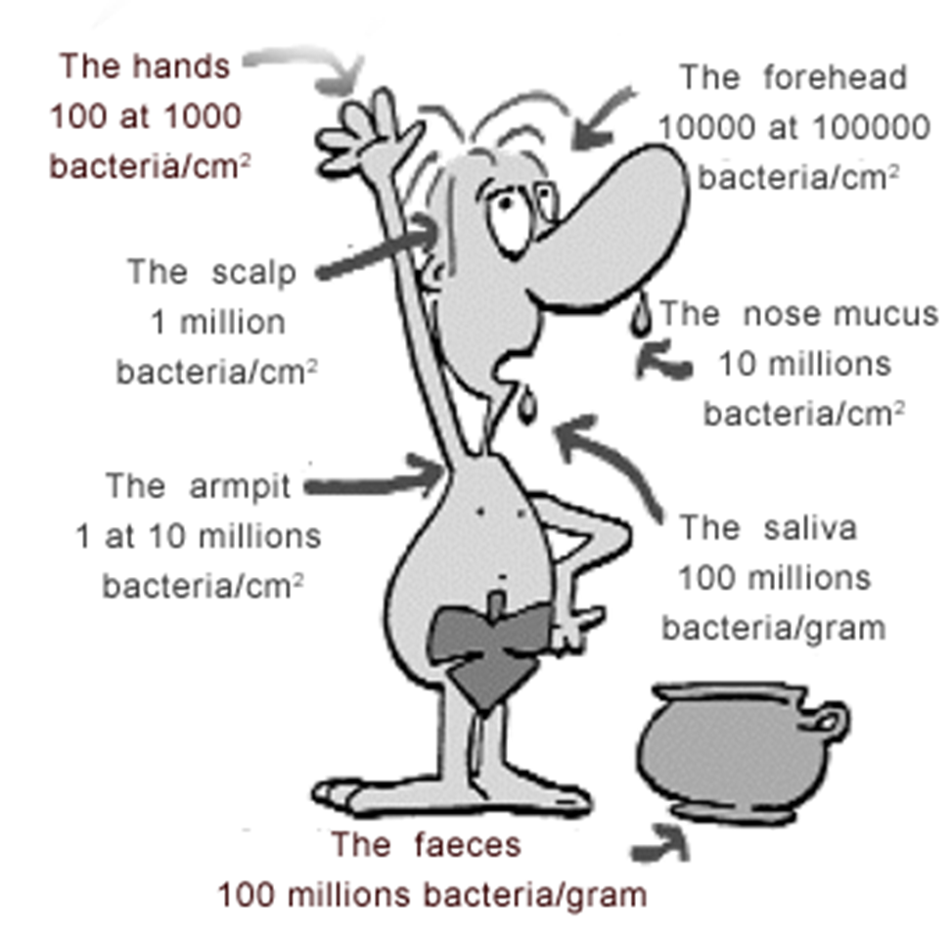
Where can you find bacteria ?
Bacteria are everywhere!
Bacteria are on your skin
The bacteria on your skin can help you from getting sick
You naturally shed bacteria which ends up on surrounding surfaces
Bacteria are in your gut to help you digest food
And they help you absorb vitamins
The bacteria in our body weighs as much as our brain - about 1.33 kg!
That’s about the weight of 2 ipads
Bacteria is all around your classroom!
Notes:
https://www.natgeokids.com/uk/primary-resource/bacteria-primary-resource/

Slide 7
Ways bacteria can be spread
Touching nose, mouth, hands
People to food
Food to people
Animals to people
People to people
Can you think of examples?

Slide 8
What do bacteria need to grow?
Time – a single bacterium can multiply to over two million in just seven hours
Warmth – bacteria grow best between 5ºC and 37ºC (which is body temperature)
Food – like any other living things, bacteria need food to grow
Water – bacteria need moisture to grow

Slide 9
How Fast can Bacteria grow?
Some bacteria like E. coli can divide every 20 minutes
In 7 hours one bacterium can generate 2,097,152 bacteria
After one more hour the number of bacteria will have risen to 16,777,216!
This rapid growth can make you sick quickly
The human population is 7.7 billion, it would take about 153 days for an E. Coli bacterium to generate more bacteria then the human population
Notes:
https://www.bbc.co.uk/bitesize/guides/z243g82/revision/2

Slide 10
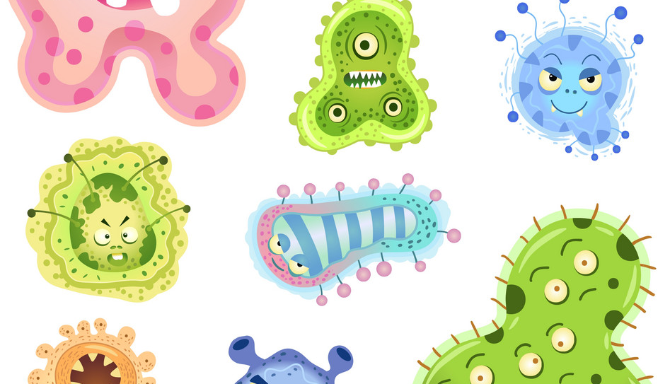
Activity Time
Let’s swab for bacteria!
Download the
“Where does Bacteria Grow”
Activity Sheet

Slide 11
Where will you find bacteria?
Where can you find germs in your home?
Pick a spot or item in you are going to swab
Make a hypothesis:
Where will have the most bacteria?
Be sure to write down what you swabbed, so you can compare results later
Draw a map of your home and plot the results to identify which spots in your home have the most bacteria

Slide 12
How do we swab for bacteria?
First, we need a swab
The swab needs to be clean, with no bacteria on it to start
If the swab is dirty, then the results of our experiment won’t work
We call this contamination
Today we will be using a cotton bud

Slide 13
How will we grow our bacteria?
We will swab our bacteria onto a sterile potato slice
Potato slices are food for the bacteria
The potato has been boiled to sterilize it, then sliced
After you swab your bacteria, immediately swab onto the potato slice
Put the potato slice in a warm, dark place
Notes:
https://www.safefood.eu/Food-safety/Food-Poisoning.aspx

Slide 14
What will our bacteria look like?
Let your bacteria grow in a warm dark place and check back in 24-48 hours.
This is called incubation
On your potato slice you will see bacterial colonies
A colony is a mass of bacteria, it can be thousands of bacteria!
Microbiologists use bacterial colonies to identify and study bacteria
Notes:
https://www.youtube.com/watch?v=WlGQaVgfpmw&t=82s

Slide 15
End of Activity
Let’s swab for bacteria!

Slide 16
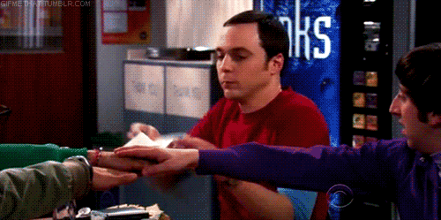
Wash your hands!
You can prevent infections by:
regularly washing your hands
prepare food hygienically
avoiding close contact with sick people
keeping vaccinations up to date
Notes:
https://www.nhs.uk/conditions/vaccinations/nhs-vaccinations-and-when-to-have-them

Slide 17
Hand washing
Keeping hands clean is one of the most important steps we can take to avoid getting sick and spreading germs
Many diseases and conditions are spread by not washing hands with soap and clean, running water
Germs can get onto hands after people use the toilet or handling raw meats
A single gram of human feaces can contain one trillion germs
That’s about the weight of a paper clip
Notes:
https://www.cdc.gov/handwashing/why-handwashing.html

Slide 18
Wash your hands!
Handwashing with soap removes germs from hands and prevent infections because:
People frequently touch their eyes, nose, and mouth without even realizing it, which is how germs can get into the body
Germs from unwashed hands can get into foods and drinks while people prepare or consume them
Germs from unwashed hands can be transferred to other objects, like handrails, table tops, or doorknobs, and then transferred to another person
Estimated global rates of handwashing after using the toilet are only 19%
Notes:
https://www.nhs.uk/live-well/healthy-body/best-way-to-wash-your-hands/

Slide 19
Activity Time
Let’s swab for bacteria!
Download the
“Handwashing”
Activity Sheet

Slide 20
Handwashing
Washing your hands, to remove bugs such as viruses and bacteria, is an important way of preventing the spread of germs which can make you sick
In this experiment we are checking to see if washing your hands reduces the number of germs present on your hands
By growing germs on potato slices!
Have an adult prepare the potato slices for you, following the instructions on the activity sheet
Make a hypothesis as to what each potato slice will look like before and after you wash your hands and explain the reasons(s) behind your hypothesis

Slide 21
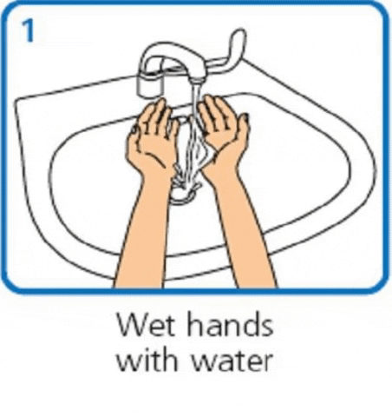
Handwashing Experiment
Rub your fingers and hands across the surface of the first potato slice
Mark the potato slice as “unwashed hands”
Wash your hands for 20 seconds using soap and following the NHS handwashing guidelines
After you have washed and dried your hands, touch a new potato slice with your fingers and hands
Close the container immediately afterwards and label potato as “washed hands”

Slide 22
Why you should wash hands
Let the potato slices in the container(s) incubate in a warm, dark place
This can be in a cupboard, near a radiator, or in a box.
Check growth after 24-48 hours
Compare the results between unwashed and washed hands
You should see a difference in the amount of growth between potato slices, showing that handwashing is an effective way of removing germs from your fingers and fighting infection

Slide 23
End of Activity
Handwashing

Slide 24
Activity Time
Let’s learn about transmission

Slide 25
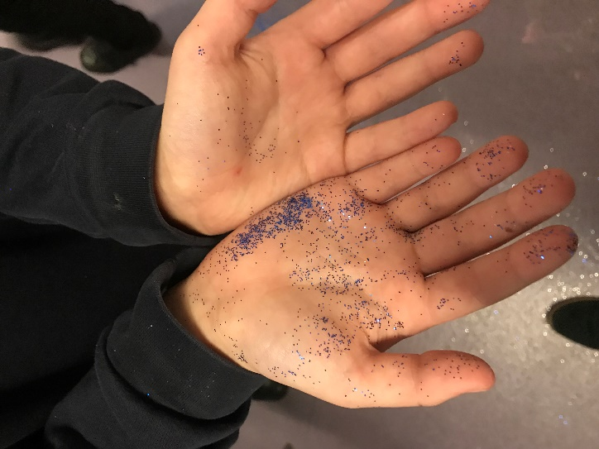
Spreading Germs
Rub glitter on your hands
Shake hands with other people in your household
See how far the glitter can spread
Where did the glitter spread?
What objects in the classroom have glitter on them? Desks? Doorknobs?
Did anyone touch their face?
You can see how quickly the glitter spreads, germs spread just as fast!
Download the Glitter Transmission Activity Sheet

Slide 26
End of Activity
Glitter Transmission

