Slide 1
Sound of the Bees

Slide 2
Introduction

Slide 3
Introduction
Notes:
Introduce the project - Pupils are going to create a digital device that captures video and sound of Bees.

Slide 4
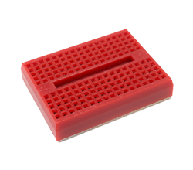
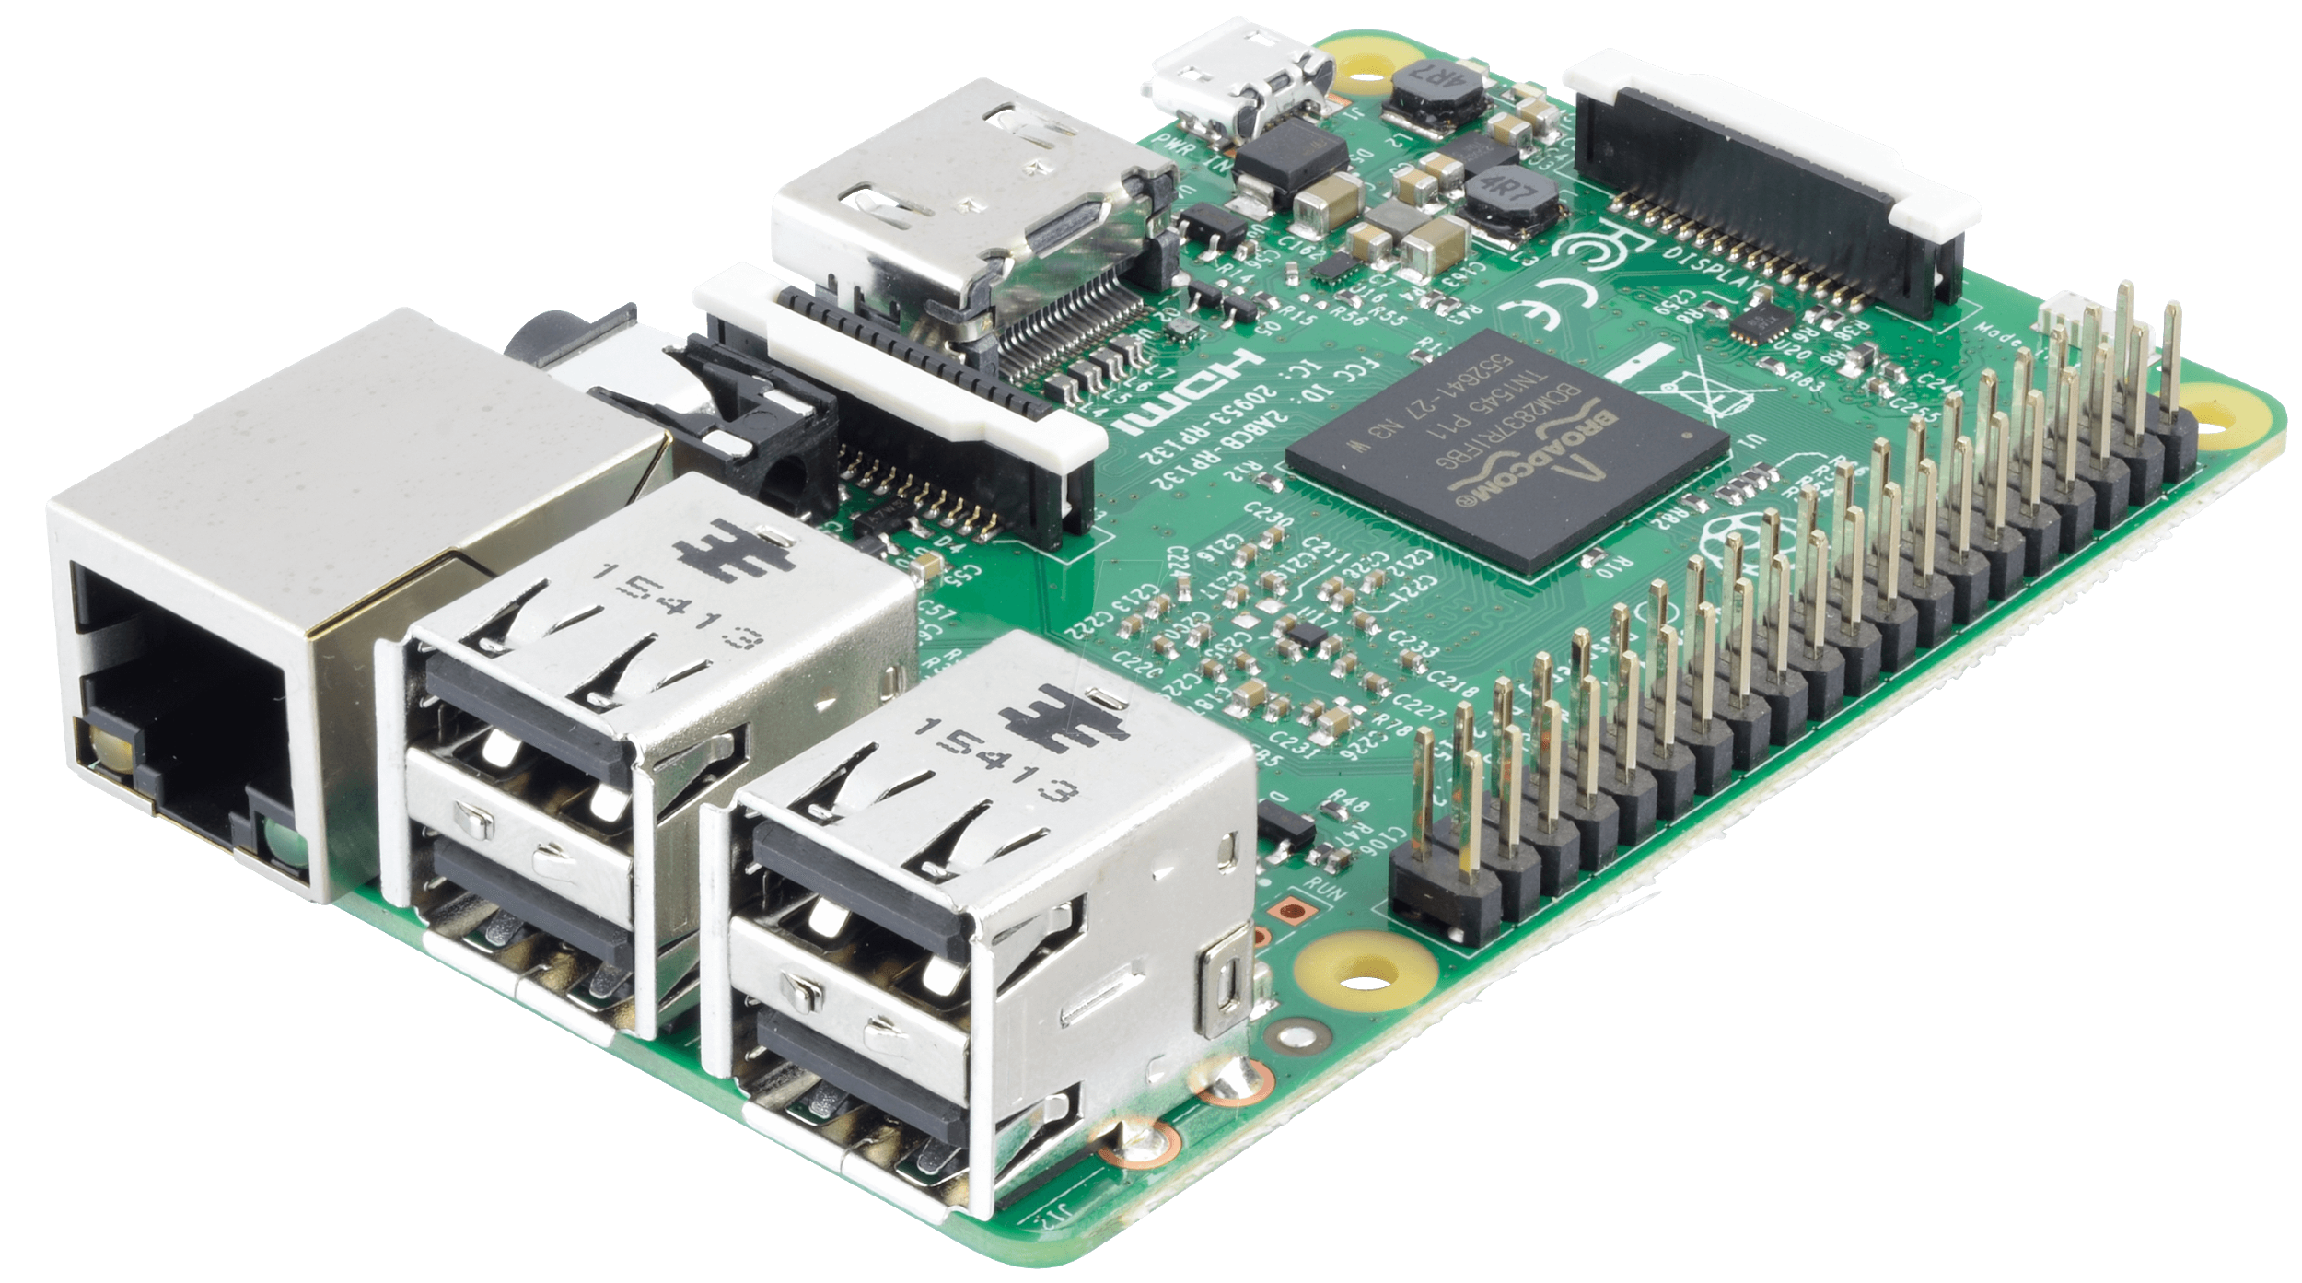
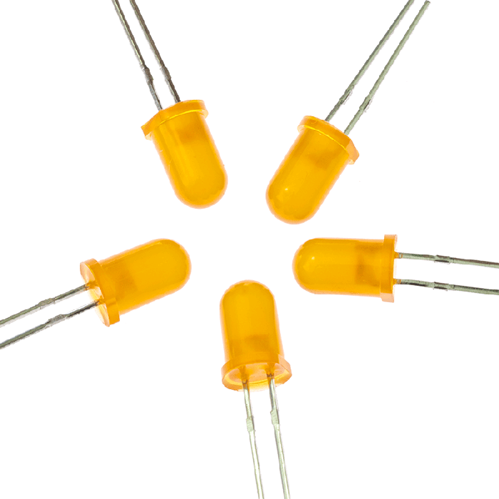
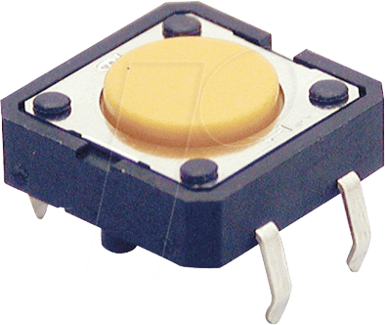
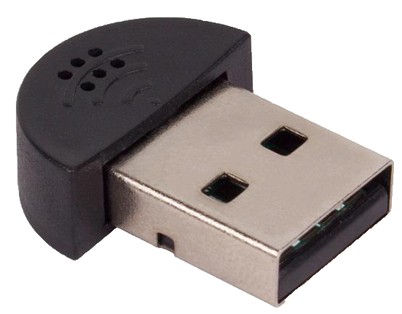
What are these?
1.
2.
3.
5.
6.
4.
Notes:
Top Row - Left to Right > Raspberry Pi, Pi digital Camera, Bread Board
Bottom Row - Left to Right > LED’s, Button, USB Microphone

Slide 5
By the end of this you will...
Understand some input and output devices on a Raspberry Pi.
Be able to build and program a simple circuit.
Use a Raspberry Pi camera to take pictures and videos.
An understanding of algorithms.

Slide 6
What do we need to think about?
Notes:
Pupil Voice

Slide 7
Task: Coding Circle
On your feet! Stand in a circle on the floor
Coding Circle Pack
Notes:
Teacher will need to print of resources in advance of the activity. This can be done as either small group of whole class.
Instructions on how to run the activity are found within the Coding Circle Activity Pack.

Slide 8
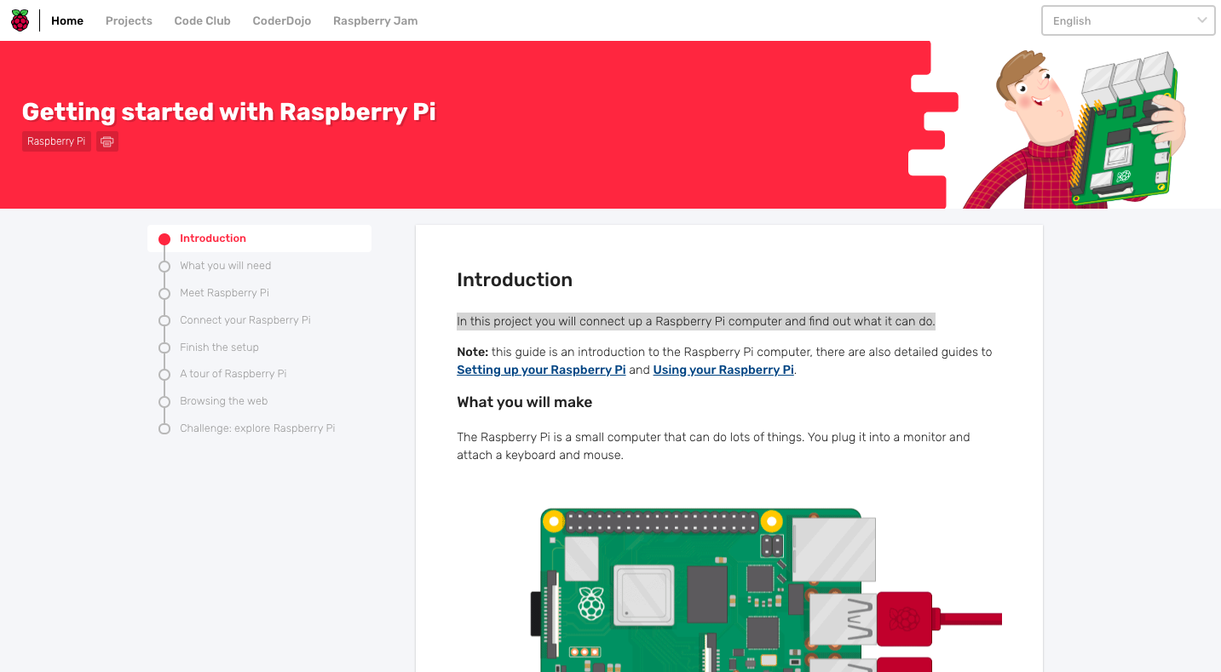
Task: Getting started with RPi
You will be connecting up a Raspberry Pi computer and find out what it can do.
You will need to follow the instructions on the project page.
Here is the quick link to getting started -
bit.ly/2RYFaCf
https://projects.raspberrypi.org/en/projects/raspberry-pi-getting-started
Notes:
Allow the pupils to follow the project page - this should take approx. 1hr 30min to complete.

Slide 9
Task: Getting started with Physical Computing
The version of Scratch included with the Raspberry Pi has a number of unique features; one of the most useful is its ability to communicate with the GPIO pins (General Purpose Input Output).
These pins allow you to connect your Raspberry Pi to a range of devices, from lights and motors to buttons and sensors.
https://projects.raspberrypi.org/en/projects/physical-computing-with-scratch
https://projects.raspberrypi.org/en/projects/physical-computing
Beginner
Advanced

Slide 10
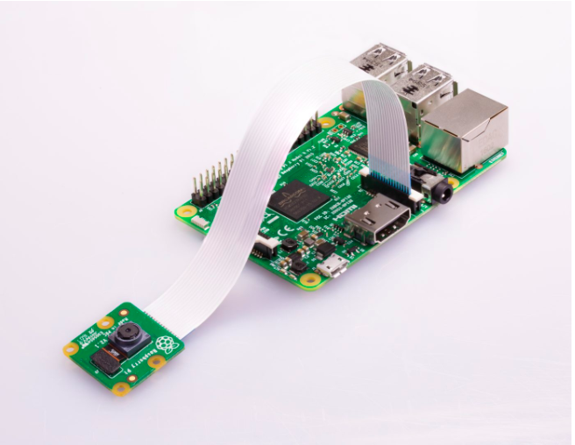
Task: Testing the Camera
You will now learn how to connect the Raspberry Pi Camera Module to your Raspberry Pi and take pictures, record video, and apply image effects.
Step 1:
Before getting started with the camera module, we will have to make sure it is enabled via the config page. To do this, you'll need to open a Raspberry Pi terminal.
Open a terminal and run:
Type > sudo raspi-config
Navigate to Interfacing Options and select Camera. Select the option to enable the camera and reboot the Pi.

Slide 11
Task: Testing the Camera
Step 2:
Once the camera module is connected, you may want to follow some of the recommended instructions from the Raspberry Pi foundation, available below:
https://projects.raspberrypi.org/en/projects/getting-started-with-picamera/2

Slide 12
Task: Testing the Camera
Step 3:
To record audio with the Pi, you can use the following command.
arecord -D plughw:1,0 -d 3 audio.wav
This records 3 seconds of audio and stores it to the Pi. It is recommended to follow the instructions below to check each part of this command is correct for your system.
http://wiki.sunfounder.cc/index.php?title=To_use_USB_mini_microphone_on_Raspbian

Slide 13
Task: The Final Program
So far, we have assembled the hardware and tested the action of the button using Scatch (or Python) to light an LED and tested our camera module with audio.
We will now bring all of this together into one command that can be run outside at the hive.
We need to do a few things to make this possible.
Write some code that says ‘if the button is pressed, start the recording' . This will embed many of the concepts from the Coding Circle activity.
Activate the code to run when the Pi starts so that we don't have to do anything with it outside at the hive. This will let us just plug it into a battery pack, press the button and start the recording.

Slide 14
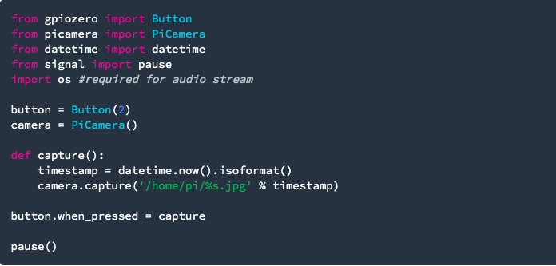
The Final Program
Step 1 (Starting the recording when the button is pressed):
Taking a picture with Python:
Following on from the Building the Hardware section, we can use Python to trigger the camera to take a photo when a button is pressed. This is covered by the following code:
This code will store the output file as a jpg in the /home/pi/ directory on the Pi. Note that we are labelling the image as the date and time to avoid overwriting, as discussed in Building the Hardware.

Slide 15
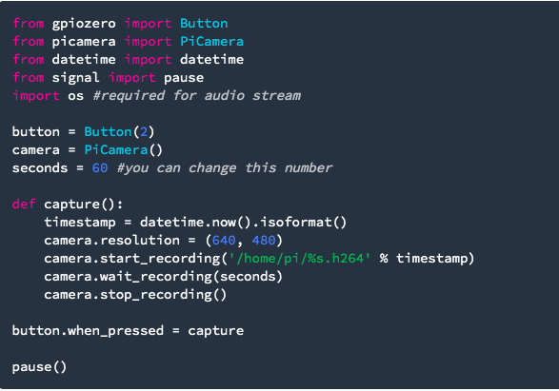
The Final Program
Taking a video with Python:
Capturing a video to a file is similar and can be done in Python as follows:
This captures 60 seconds of footage and stores it in the /home/pi/ directory on the Pi.

Slide 16
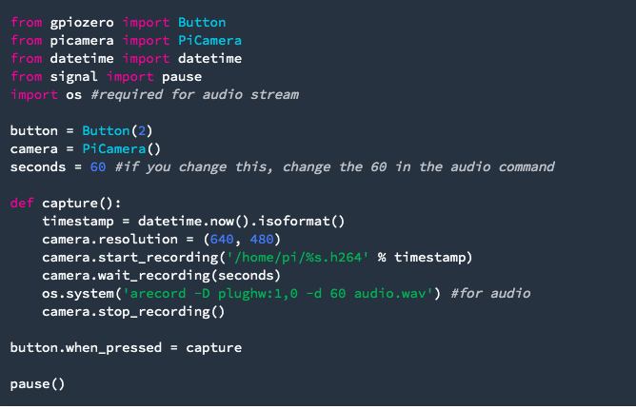
The Final Program
Taking a video and recording audio with Python:
You can add the audio stream by adding a line as follows:

Slide 17
The Final Program
Step 2 (Set the code to run when the Pi starts up):
There are multiple ways to set your Python file to run when the Raspberry Pi loads up. Firstly, make sure you have the code from Step 1 saved on your Pi somewhere that you can find it. It is probably sensible to name it something like startVideo.py and store it in your /home/pi/ directory.
Method: .bashrc
The second method to run a program on your Raspberry Pi at startup is to modify the .bashrc file. With the .bashrc method, your python program will run on boot and also every time when a new terminal is opened, or when a new SSH connection is made. Put your command at the bottom of ‘/home/pi/.bashrc’. The program can be aborted with ‘ctrl-c’ while it is running!
Finally, reboot the Pi
Go to the last line of the script and add:

Slide 18
The Final Program
Taking a video and recording audio with Python:
You can add the audio stream by adding a line as follows:

Slide 19
Conclusion
Congratulations, you have reached the end of the tutorial. Good luck!

Slide 20
Resource Contributors
Cardiff University School of Pharmacy
Wellcome Trust
Cardiff Commitment
Bridgend College
Cardiff Schools’ e-Learning Support

